Slide 1
Project
Geography and
History
9th Grade
Team Infinity

Slide 2
Menu
01
02
Team
The idea of the project
03
04
The structure of the website
Stages of realization
05
Used applications

Slide 3
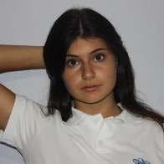
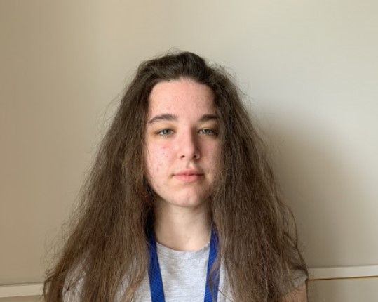
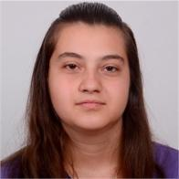
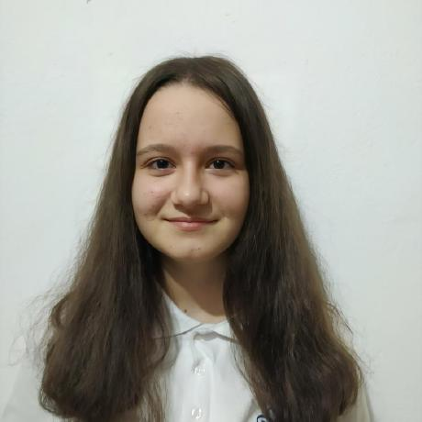
Team
Scrum Trainer
Frontend Developer
Backend Developer
Designer
Coordinates the activity, sets deadlines and sets tasks, creates the project in GitHub. Describes the purpose of the project, the general description of the game or site, the stages of work and the conclusion, sources of information.
Structure and navigation of the site, structure of HTML & CSS documents.
Types of data used in JS, functions and parameters, as well as their purpose, JS tests
Color scheme and fonts used for design, license rights for graphic objects.

Slide 4
The idea of the project
This site is made to promote the Strandzha Nature Park. It contains a menu with 5 options "Home", "Regions" with two submenus "Malko Tarnovo" and "Tsarevo","Game" and "Contacts". Each submenu contains photos and information and the game contains 10 optional questions.

Slide 5
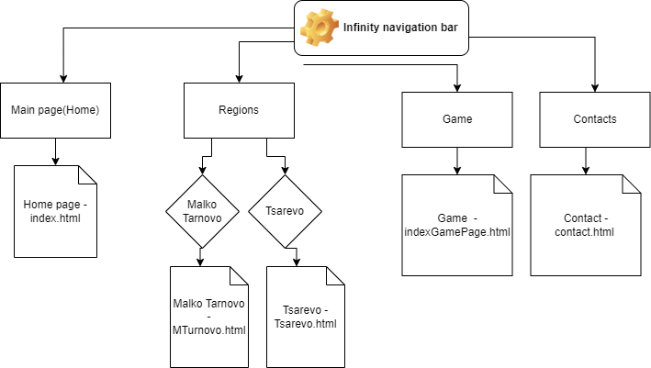
The structure of the website

Slide 6
Stages for realization
Clarification of the main purpose of the project
Creating repository in GitHub
Selection of information and images
Creating a index page - effects
Creating other regions pages
Creating the game
Creating a contact page
Connecting the parts into a completed product
Creating presentation, documentation and ReadMe file

Slide 7





Used applications

Slide 8

Thanks for your attention!

